Slide 1

Future Analysis
+
Recommendations

Slide 2
Improved methods of modeling customer success

Slide 3
Improved methods of modeling customer success
2) Discount Risk Mitigation

Slide 4
Improved Modeling Method
Current Challanges
Sales predictions are not necessarily based off previous sales

Slide 5
Improved Modeling Method
Current Challanges
Sales predictions are not necessarily based off previous sales
We are actually asking for a prediction of the B2B partner's success

Slide 6
Improved Modeling Method
Current Challanges
Sales predictions are not necessarily based off previous sales
We are actually asking for a prediction of the B2B partner's success
Location plays a much great factor than initially realized

Slide 7




Feature engineering
Clustering
Census Data
Yelp Data
Google Analytics

Slide 8
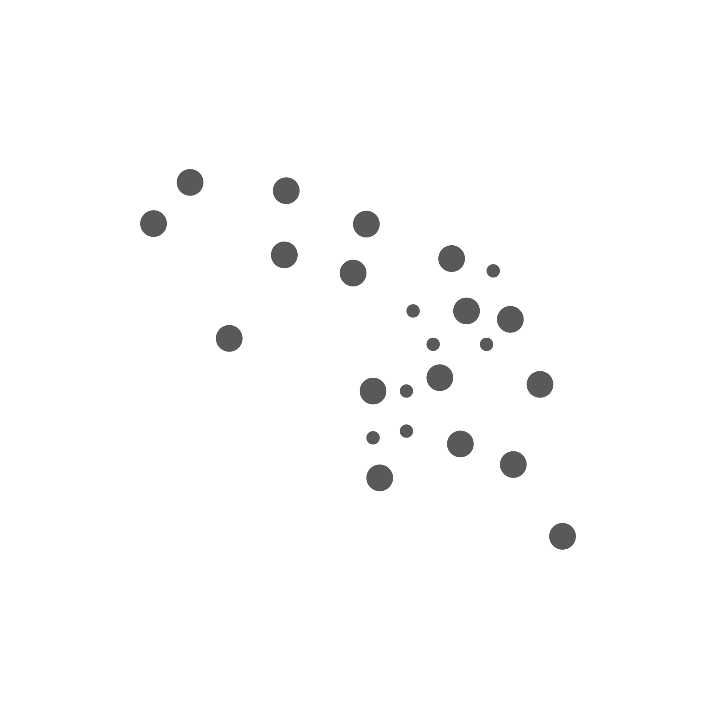



Features engineering
Clustering
Census Data
Yelp Data
Google Analytics
This strategy provides a tailored analysis for each location and the assigned sales rep

Slide 9
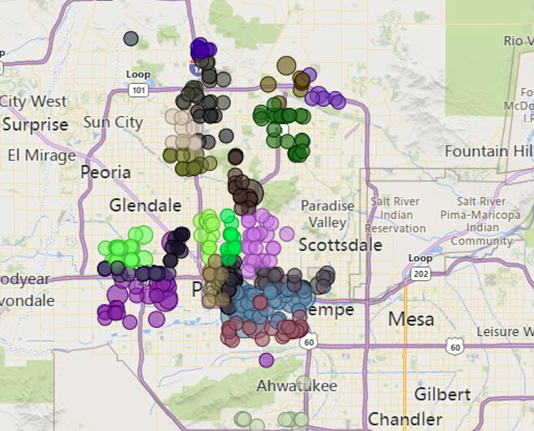
Improved Modeling Method

Slide 10
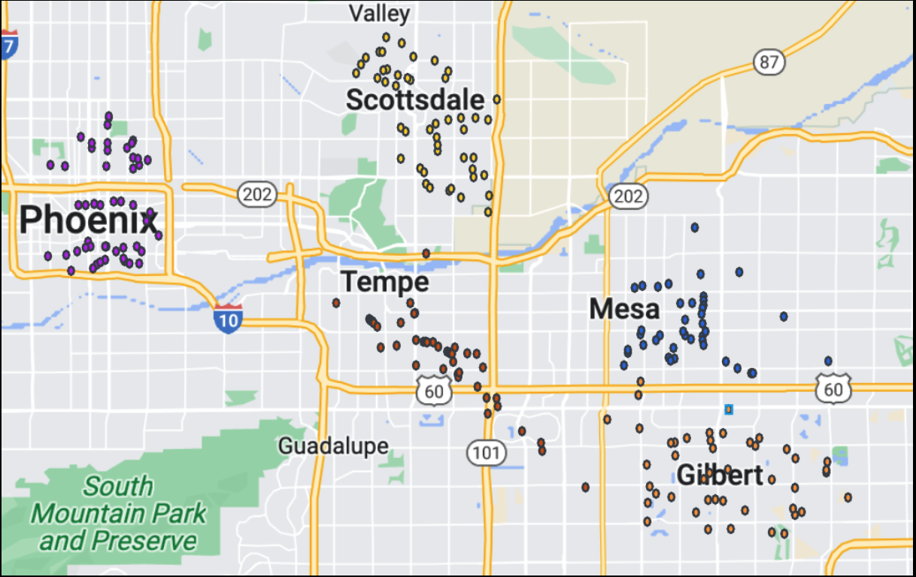
Improved Modeling Method
Notes:
Breakout the current B2B Partners into clusters
Add census data to the existing FFSOP data, as well as yelp data and Google Analytics data
3) Choose an appropriate model such as XGBoost
4) The data can be evaluated for a desired target variable

Slide 11
Improved Modeling Method
Mostly businesses: Customers + working professionals
Notes:
Breakout the current B2B Partners into clusters
Add census data to the existing FFSOP data, as well as yelp data and Google Analytics data
3) Choose an appropriate model such as XGBoost
4) The data can be evaluated for a desired target variable

Slide 12
Improved Modeling Method
Mostly businesses: Customers + working professionals
Very wealthy area. Customers would be affluent
Notes:
Breakout the current B2B Partners into clusters
Add census data to the existing FFSOP data, as well as yelp data and Google Analytics data
3) Choose an appropriate model such as XGBoost
4) The data can be evaluated for a desired target variable

Slide 13
Improved Modeling Method
Mostly businesses: Customers + working professionals
Very wealthy area. Customers would be affluent
Customers are middle class full of suburbs
Notes:
Breakout the current B2B Partners into clusters
Add census data to the existing FFSOP data, as well as yelp data and Google Analytics data
3) Choose an appropriate model such as XGBoost
4) The data can be evaluated for a desired target variable

Slide 14
Improved Modeling Method
Mostly businesses: Customers + working professionals
Very wealthy area. Customers would be affluent
Customers are middle class full of suburbs
Popular tourist area as well as a large amount of college students and bars
Notes:
Breakout the current B2B Partners into clusters
Take the cluster that the potential B2B partner would be assigned to and combine the provided FSOP data with useful US census data (ex: age, medium income, home ownership, household size...etc) Census data for that cluster will be used to determine if the location of the potential B2B Partner is servicing similar customers to the rest of the cluster. If the census data dramatically changes then we know the
Potential B2B partner might be in the wrong cluster or neighborhood (location)
3) A random forest or XGBoosted tree model can be created and performed on that specific cluster to predict whether or not a potential B2B partner would be successful in that geographical area. A variety of target variables can be utilized such as transactions, profit, and even customer lifetime value.
4) I would recommend creating a regression model for a specific cluster vs the entiere database. The reason is simply due to the difference in effect that a location has on a restaurant. Customer preference is different depending on the state, city, and even locations within a city. These preferences are not with regards to their choice of Coco-Cola's line-up of drinks. This has to do with a customer's preference in restaurant offerings and locations.

Slide 15
Improved Modeling Method
Mostly businesses: Customers + working professionals
Very wealthy area. Customers would be affluent
Customers are middle class full of suburbs
Popular tourist area as well as a large amount of college students and bars
Upper-Middle Class. Full of suburbs
Notes:
Breakout the current B2B Partners into clusters
Add census data to the existing FFSOP data, as well as yelp data and Google Analytics data
3) Choose an appropriate model such as XGBoost
4) The data can be evaluated for a desired target variable

Slide 16
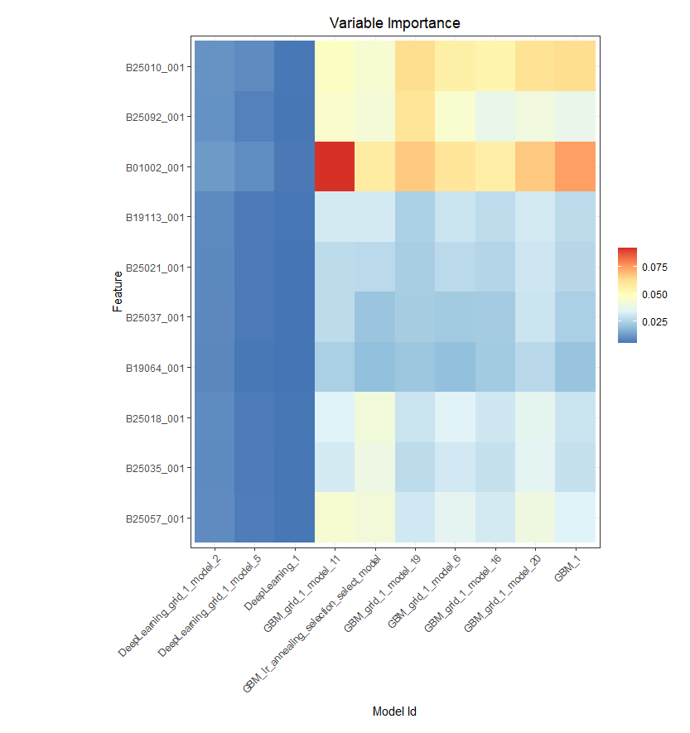
Total Profit for EATING/DRINKING with Auto ML
Avg. Household Size
Median Monthly Owner Costs
Median Age
Median Family Income
Median # of Rooms
Median Year Structure by rent/own
Aggregate Interest/Dividends/Rental Income
Median # of Rooms
Median Year Structure Built
Lower Contract Rent Quartile ($)
Census Data
Notes:
Adding new features will help us to build an accurate and effective model. Adding Average stars and total number or even average number of reviews to a dataset can be very effective. This data can be obtained through Yelps api and then merged based upon a geographical coordinates. If no similar restaurant are in the area, then we might have a strong indication that the restaurant might not do well based off of local tastes.

Slide 17
Swires's Target Market Demographic
Potential B2B Partner's Demographic
AGE
75% MATCH
AGE
Census Data
GENDER
40% MATCH
GENDER
MEDIUM INCOME
90% MATCH
MEDIUM INCOME
Notes:
Coke should have a marketing team that knows metrics and demographics about Coke’s customer. The target demographic provided by marketing (usually consumer data/reports) could be compared against the demographics of the potential B2B Partner to see how well they match. We can use a rating system to rate the quality of the potential B2B Partners of that surrounding demographic. The better the rating the better we can assume that the model can predict a store's success.

Slide 18
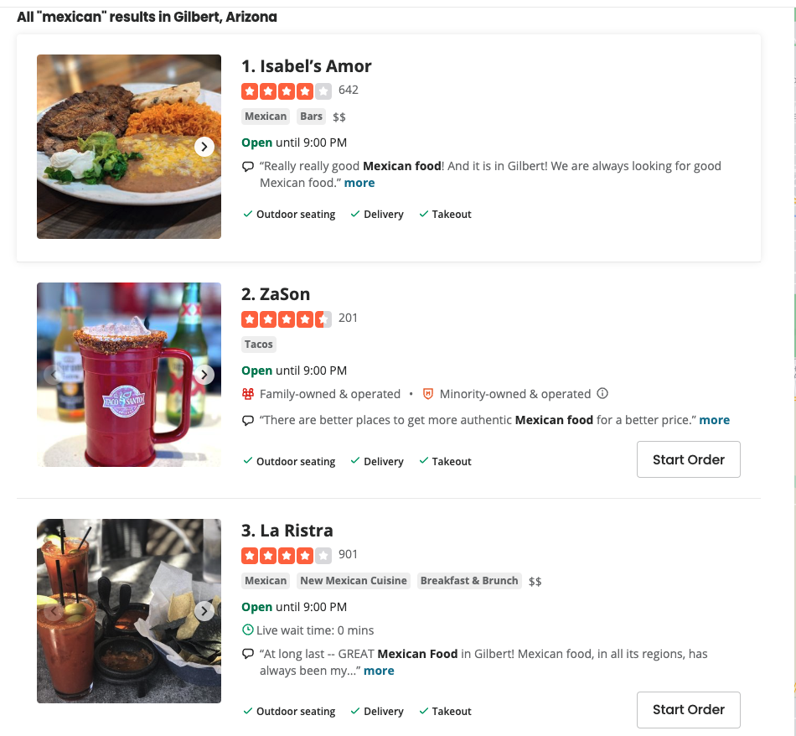
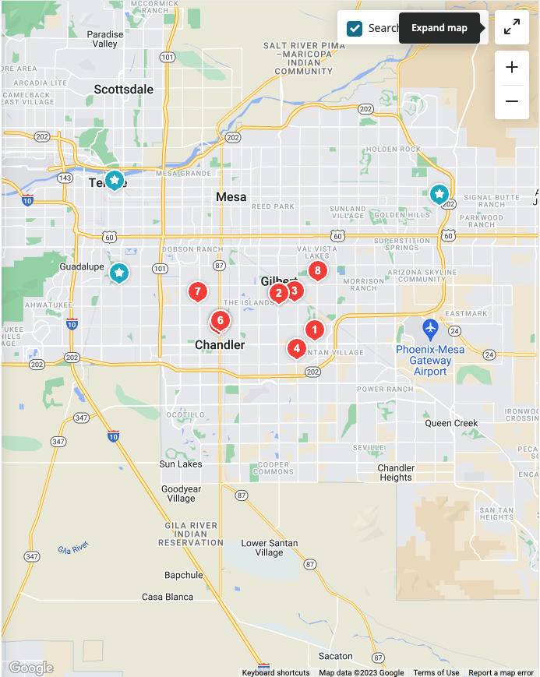
Improved Modeling Method
Yelp Data
Notes:
Adding new features will help us to build an accurate and effective model. Adding Average stars and total number or even average number of reviews to a dataset can be very effective. This data can be obtained through Yelps api and then merged based upon a geographical coordinates. If no similar restaurant are in the area, then we might have a strong indication that the restaurant might not do well based off of local tastes.

Slide 19
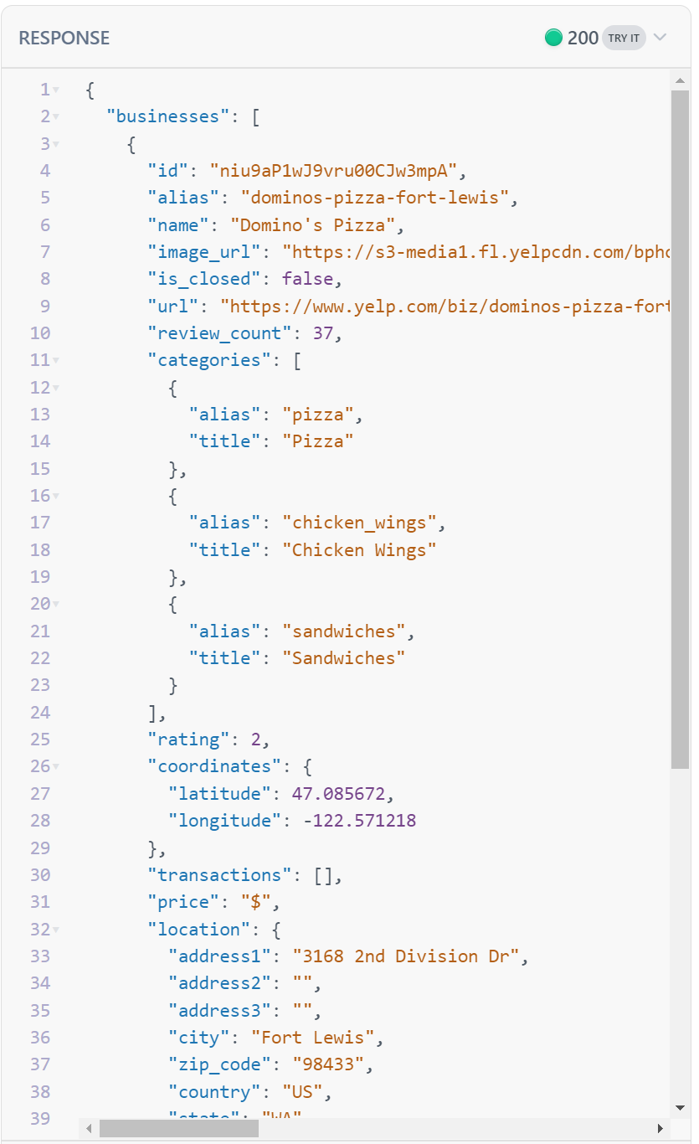
Improved Modeling Method
SEO
What is a business doing to promote itself, rank higher is searches?
Reputation
How is the business perceived by the public?
How often are they getting reviews?
Yelp Data
Notes:
Adding new features will help us to build an accurate and effective model. Adding Average stars and total number or even average number of reviews to a dataset can be very effective. This data can be obtained through Yelps api and then merged based upon a geographical coordinates. If no similar restaurant are in the area, then we might have a strong indication that the restaurant might not do well based off of local tastes.

Slide 20
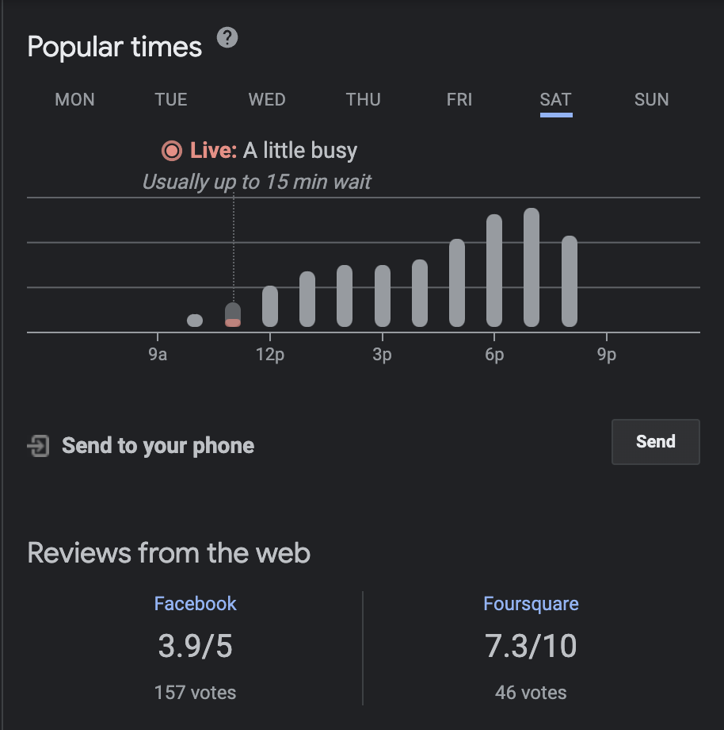
Improved Modeling Method
Google Analytics
Notes:
You can use a combination of Selenium and Beautifulsoup in Python to construct the scraper to retrieve Popular time, wait times, and visit duration. This will assist in figuring out how busy the restaurants are in the perspective area. The additional information will help assist in building a more accurate model with regards to clustering and regression. We can also use this data to produce a visual representation of how busy restaurants are by time for a given area. For example, looking at Tempe, we can compare how busy QSR-Mexican restaurants are vs QSR-Pizza and so on. Such representations can be utilized in a power bi dashboard to aid in identifying how busy specific areas are.
The busier a restaurant or restaurants are, and the longer the wait time, the more we an make an inference that these current B2B partners are successful and potentially more profitable Coca-Cola distributers.

Slide 21
END

Slide 22
Q + A

